Slide 1
Hackathon
Team: Kaviyavalli A

Slide 2
Theme: DEVELOPING A BLOCKCHAIN-BASED EVAULT FOR LEGAL RECORDS
The eVault system should be based on a blockchain platform such as Ethereum, Hyperledger, or Corda, should use smart contracts to manage access, permissions, and transactions.
The system should have user-friendly interfaces for the stakeholders to interact with the eVault, with features such as uploading and retrieving documents, tracking changes, and sharing information.
The system should ensure the privacy and confidentiality of legal records, with appropriate access controls, encryption, and authentication mechanisms.
The system should allow for seamless integration with existing databases, to ensure interoperability and ease of use.
The system should be scalable and adaptable to accommodate future changes and upgrades.

Slide 3
Solution methodology
To develop a blockchain-based eVault for legal records, begin by analyzing requirements and gathering stakeholder input to address specific legal record management needs. Design the system architecture, including robust security protocols and a user-friendly interface. Choose a suitable blockchain platform, such as Ethereum or Hyperledger, and develop secure smart contracts for record management. Implement encryption and distributed storage solutions like IPFS for data protection. Integrate the eVault with existing legal systems using APIs. Conduct thorough testing, validate against requirements, and deploy the system. Provide user training, set up monitoring for performance and security, and ensure ongoing compliance with legal standards through regular audits.

Slide 4
Network parameters
Blockchain Platform: Ethereum or Hyperledger
Consensus Mechanism: Proof of Authority (PoA) or Practical Byzantine Fault Tolerance (PBFT)
Node Types: Full nodes for all stakeholders (e.g., law firms, courts) and light nodes for end-users
Network Size: Start with a pilot network of 10-20 nodes, scalable based on adoption
Block Time: 5-15 seconds, adjustable based on network load and transaction volume
Transaction Throughput: Minimum of 100 transactions per second (tps) to accommodate legal record operations
Data Storage: Use InterPlanetary File System (IPFS) for off-chain storage, linked to on-chain records

Slide 5
Network parameters
Encryption Standards: Advanced Encryption Standard (AES) 256-bit for data at rest and Secure Socket Layer (SSL)/Transport Layer Security (TLS) for data in transit
Smart Contract Language: Solidity (Ethereum) or Chaincode (Hyperledger)
Access Control: Role-based access control (RBAC) with multi-signature authentication for sensitive transactions
Scalability Solutions: Implement Layer 2 scaling solutions like state channels or sidechains to handle increased load
Interoperability: Ensure compatibility with existing legal systems and standards through APIs and middleware

Slide 6
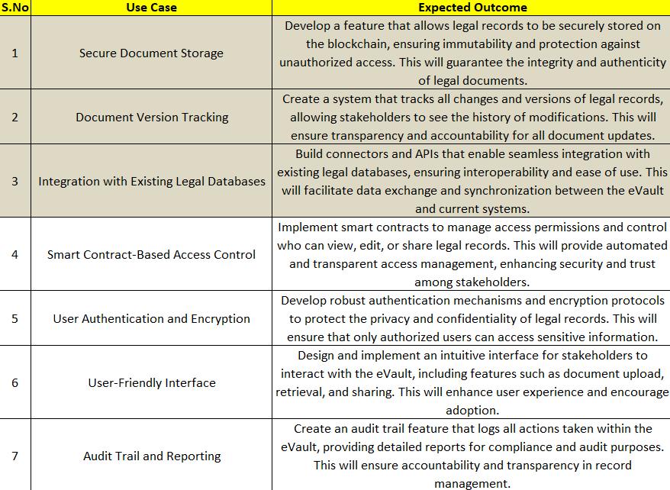
Dataset

Slide 7
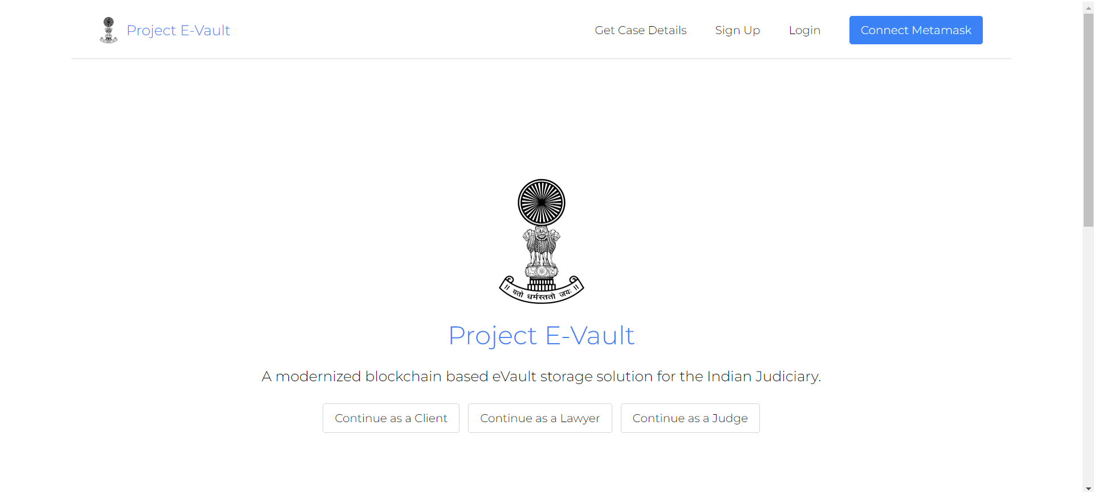
Output

Slide 8
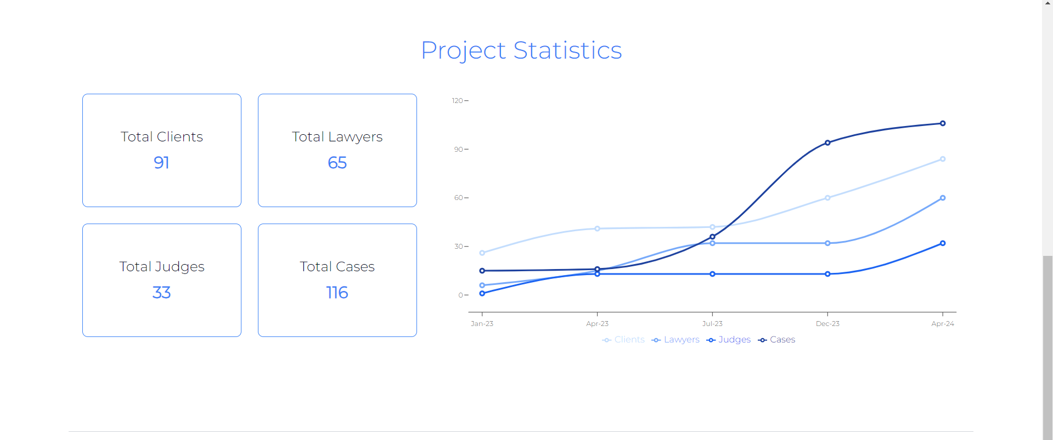

Slide 9
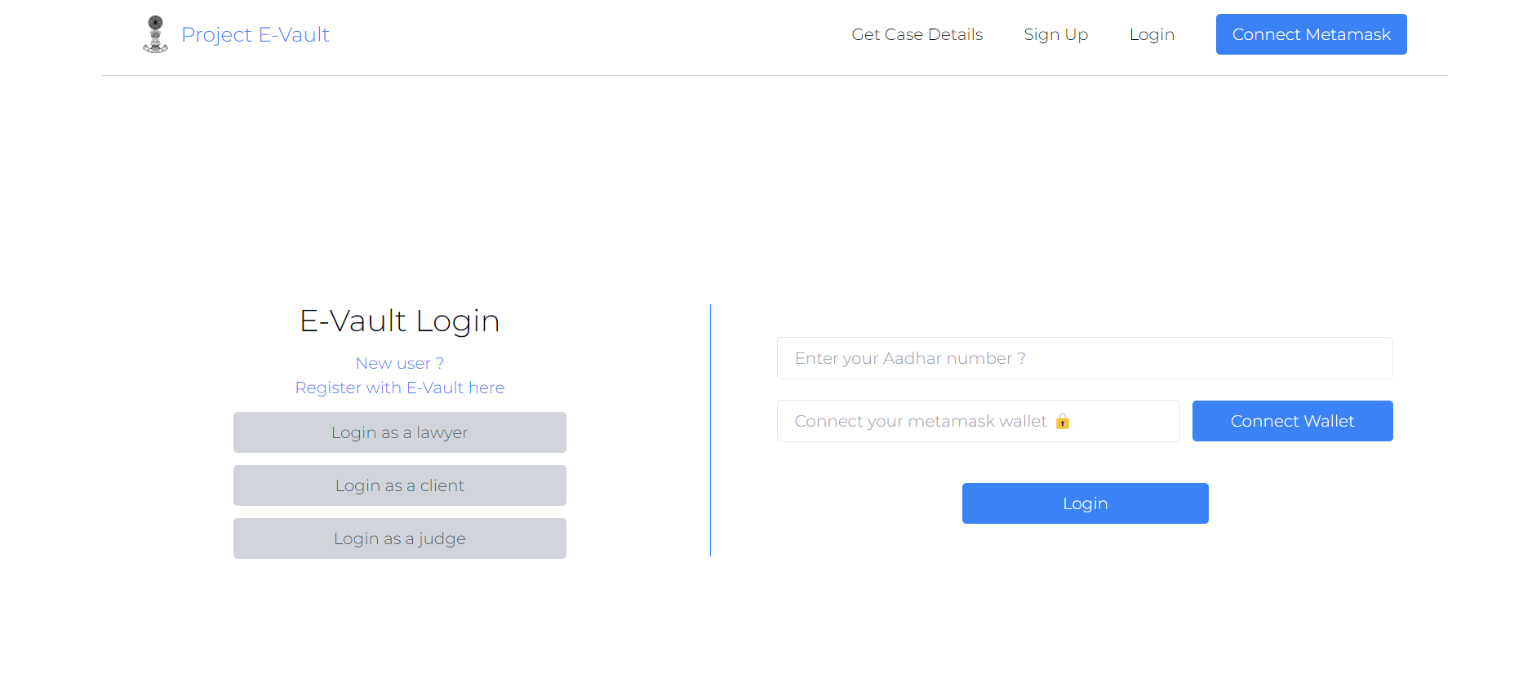

Slide 10
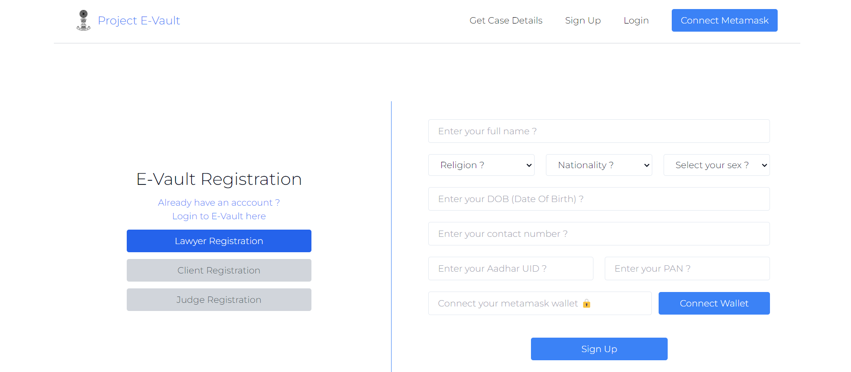

Slide 11
Impact
Enhanced Security
Improved Transparency
Regulatory Compliance
Stakeholder Trust
Scalability
It supports high transaction throughput and efficient consensus mechanisms.

Slide 12
Thankyou

